Slide 1





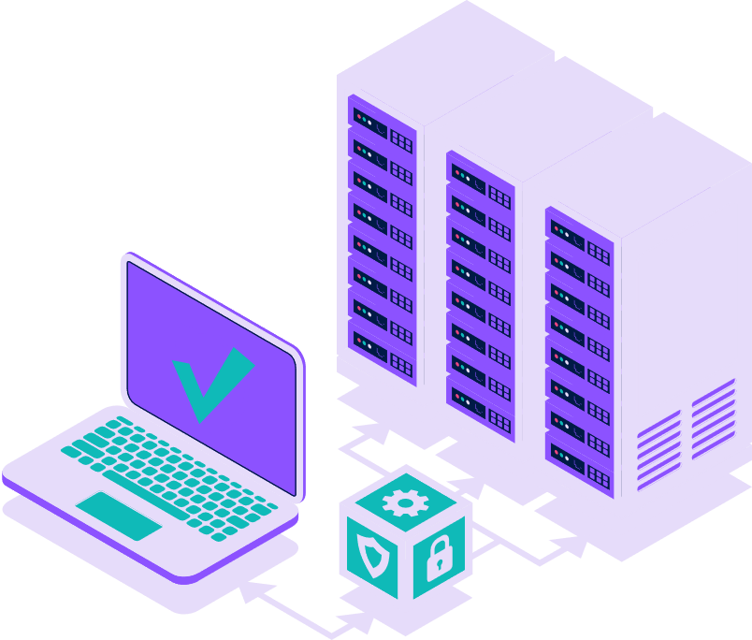
Railway Management
System

Slide 2





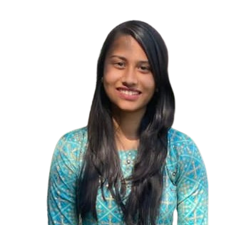
Meet Our Team
ABOUT US
Manushi Oza
Yagna Patel
Mansi Parmar
Dhairya Patel
Virti Shah
S1 31
CE
21002170110083
S1 05
CE
21002170110128
S1 11
IT
21002170210056
S1 06
IT
21002170210060
S1 02
CE
21002170110208

Slide 3


Introduction!
Database is an organized collection of data. The data is typicallyorganized to models aspects of reality in the way that supports processesrequired information.
The main purpose of maintaining database for Railway ReservationSystem is to reduce the manual errors involved in the booking andcancelling of tickets and make it convenient for the customers andproviders to maintain the data about their customers and also about theseats available at them. Due to automation many loopholes that exist inthe manual maintainance of the records can be removed.

Slide 4

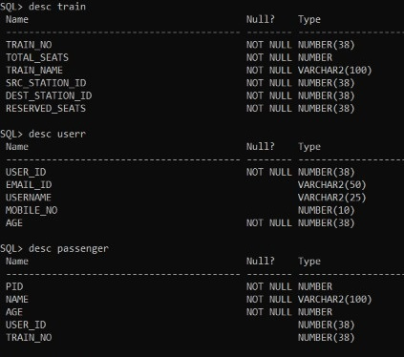
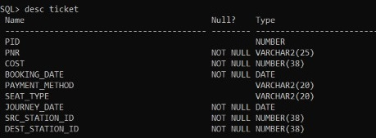
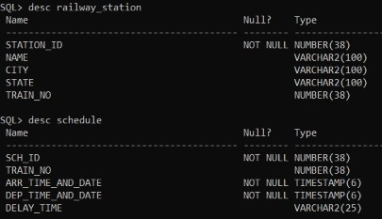
List Of Tables

Slide 5
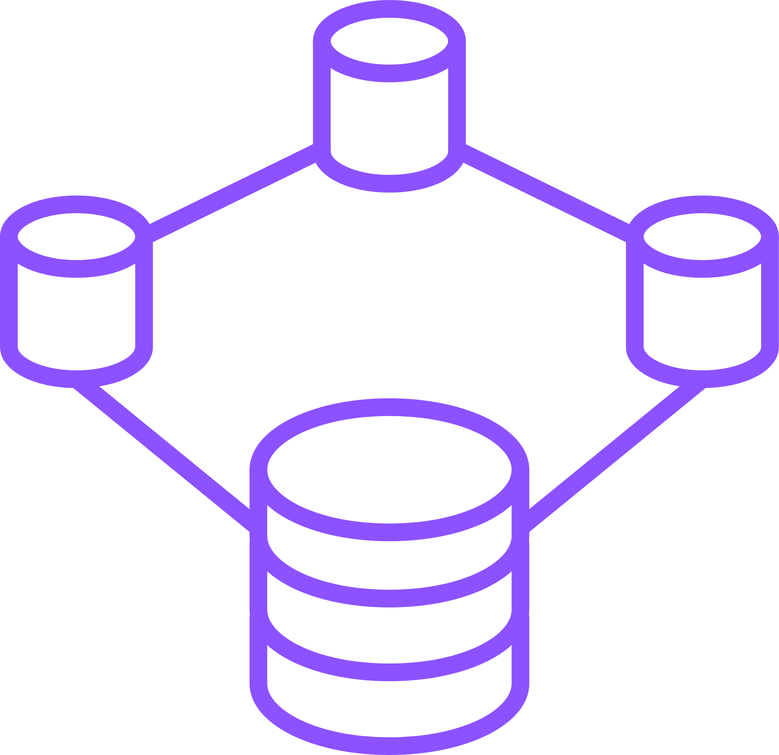

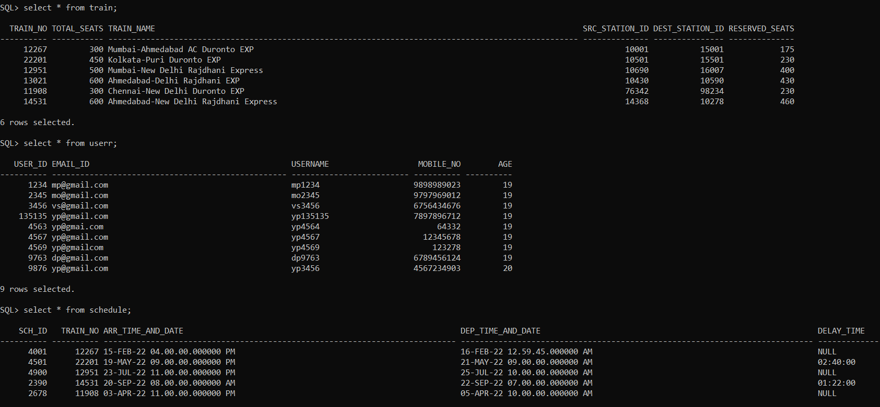
Initial Table

Slide 6

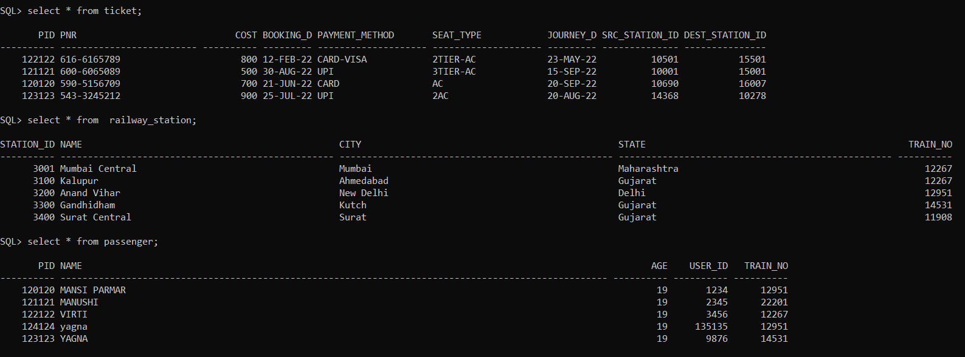
Initial Table

Slide 7

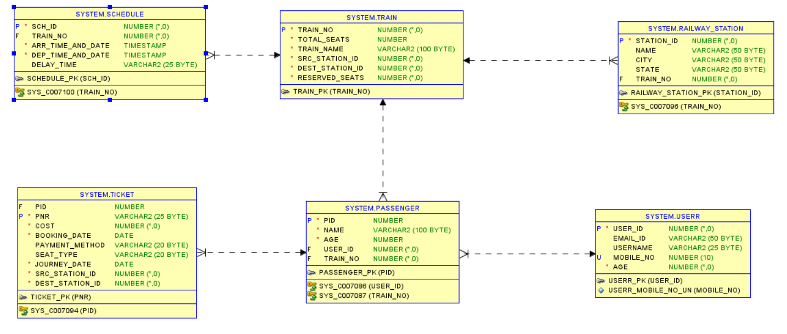
Diagram

Slide 8
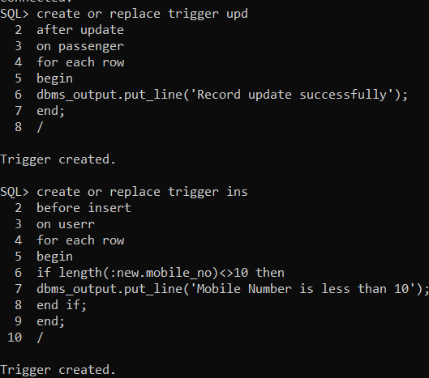
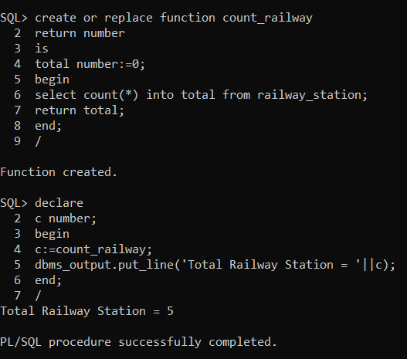

Triggers & Procedure

Slide 9

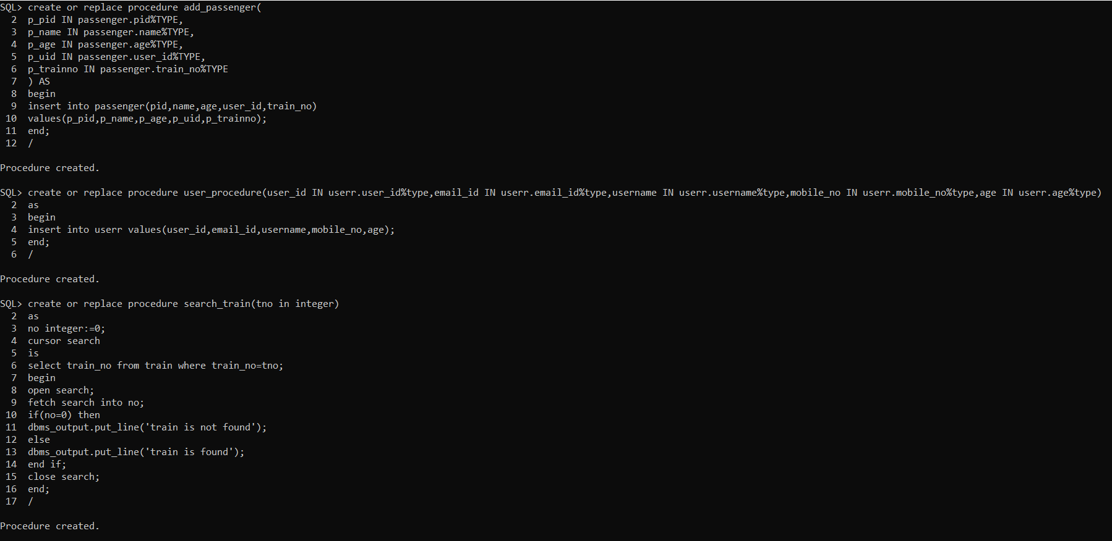
Functions & Procedure

Slide 10
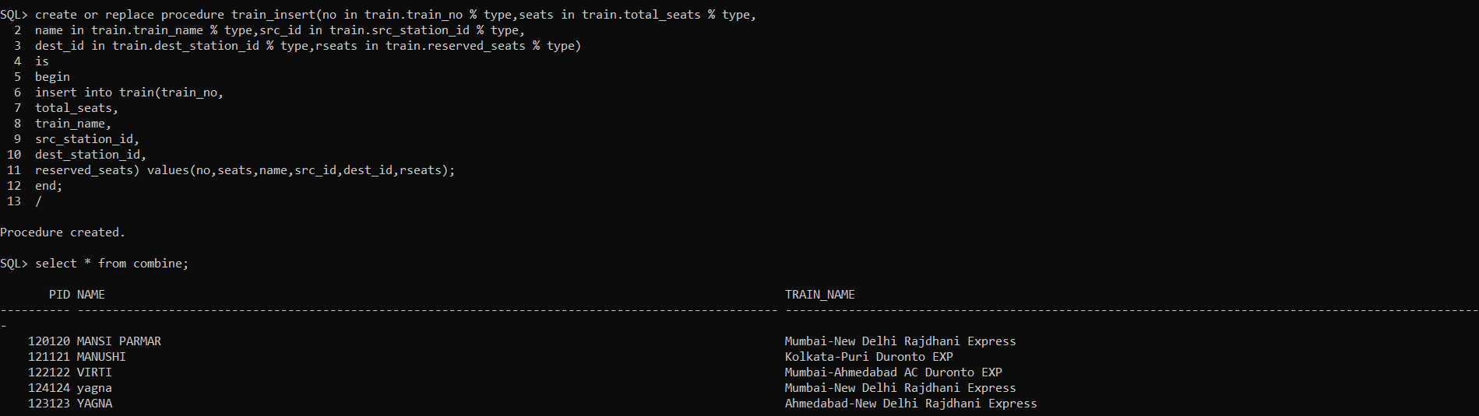
Views & Procedure

Slide 11
Thank You !!!

